Slide 1
about:other projects
Conference/event name
Location
name
openSUSE Ambassador
name@opensuse.org

Slide 2
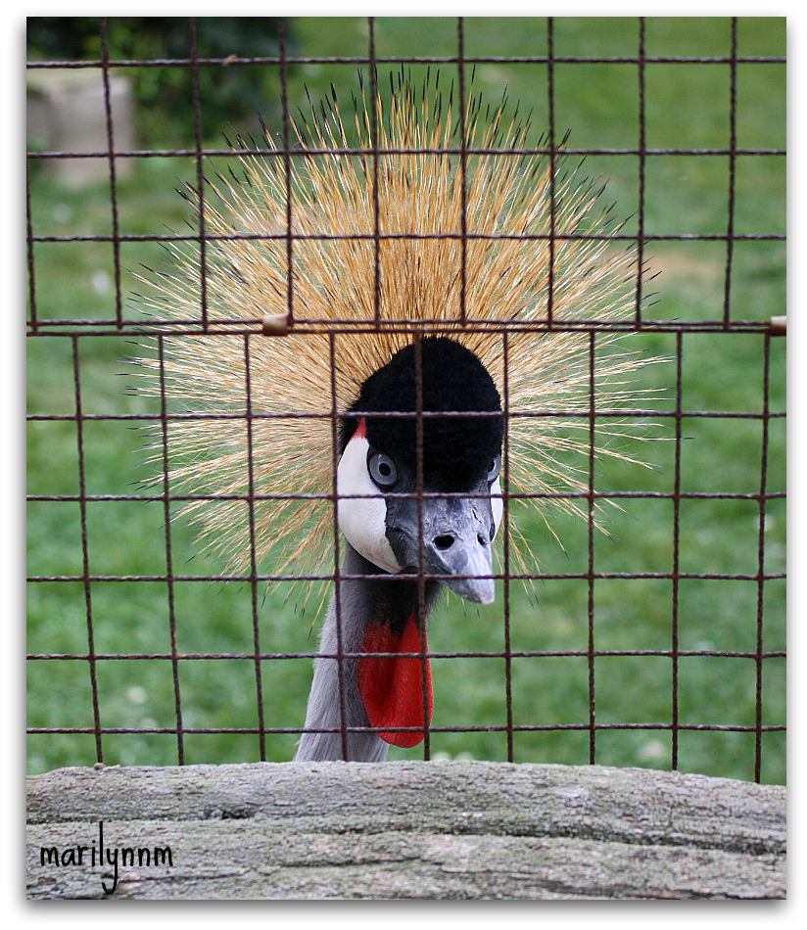
Me
Notes:
about yourself!

Slide 3
SUSE Studio
Tumbleweed
openQA
Notes:
We will talk about 3 different openSUSE (based) projects besides the openSUSE distribution and the Open Build Service:
SUSE Studio (Novell product)
Project Bretzn (openSUSE/KDE)
Appstream (openSUSE/cross distro)

Slide 4
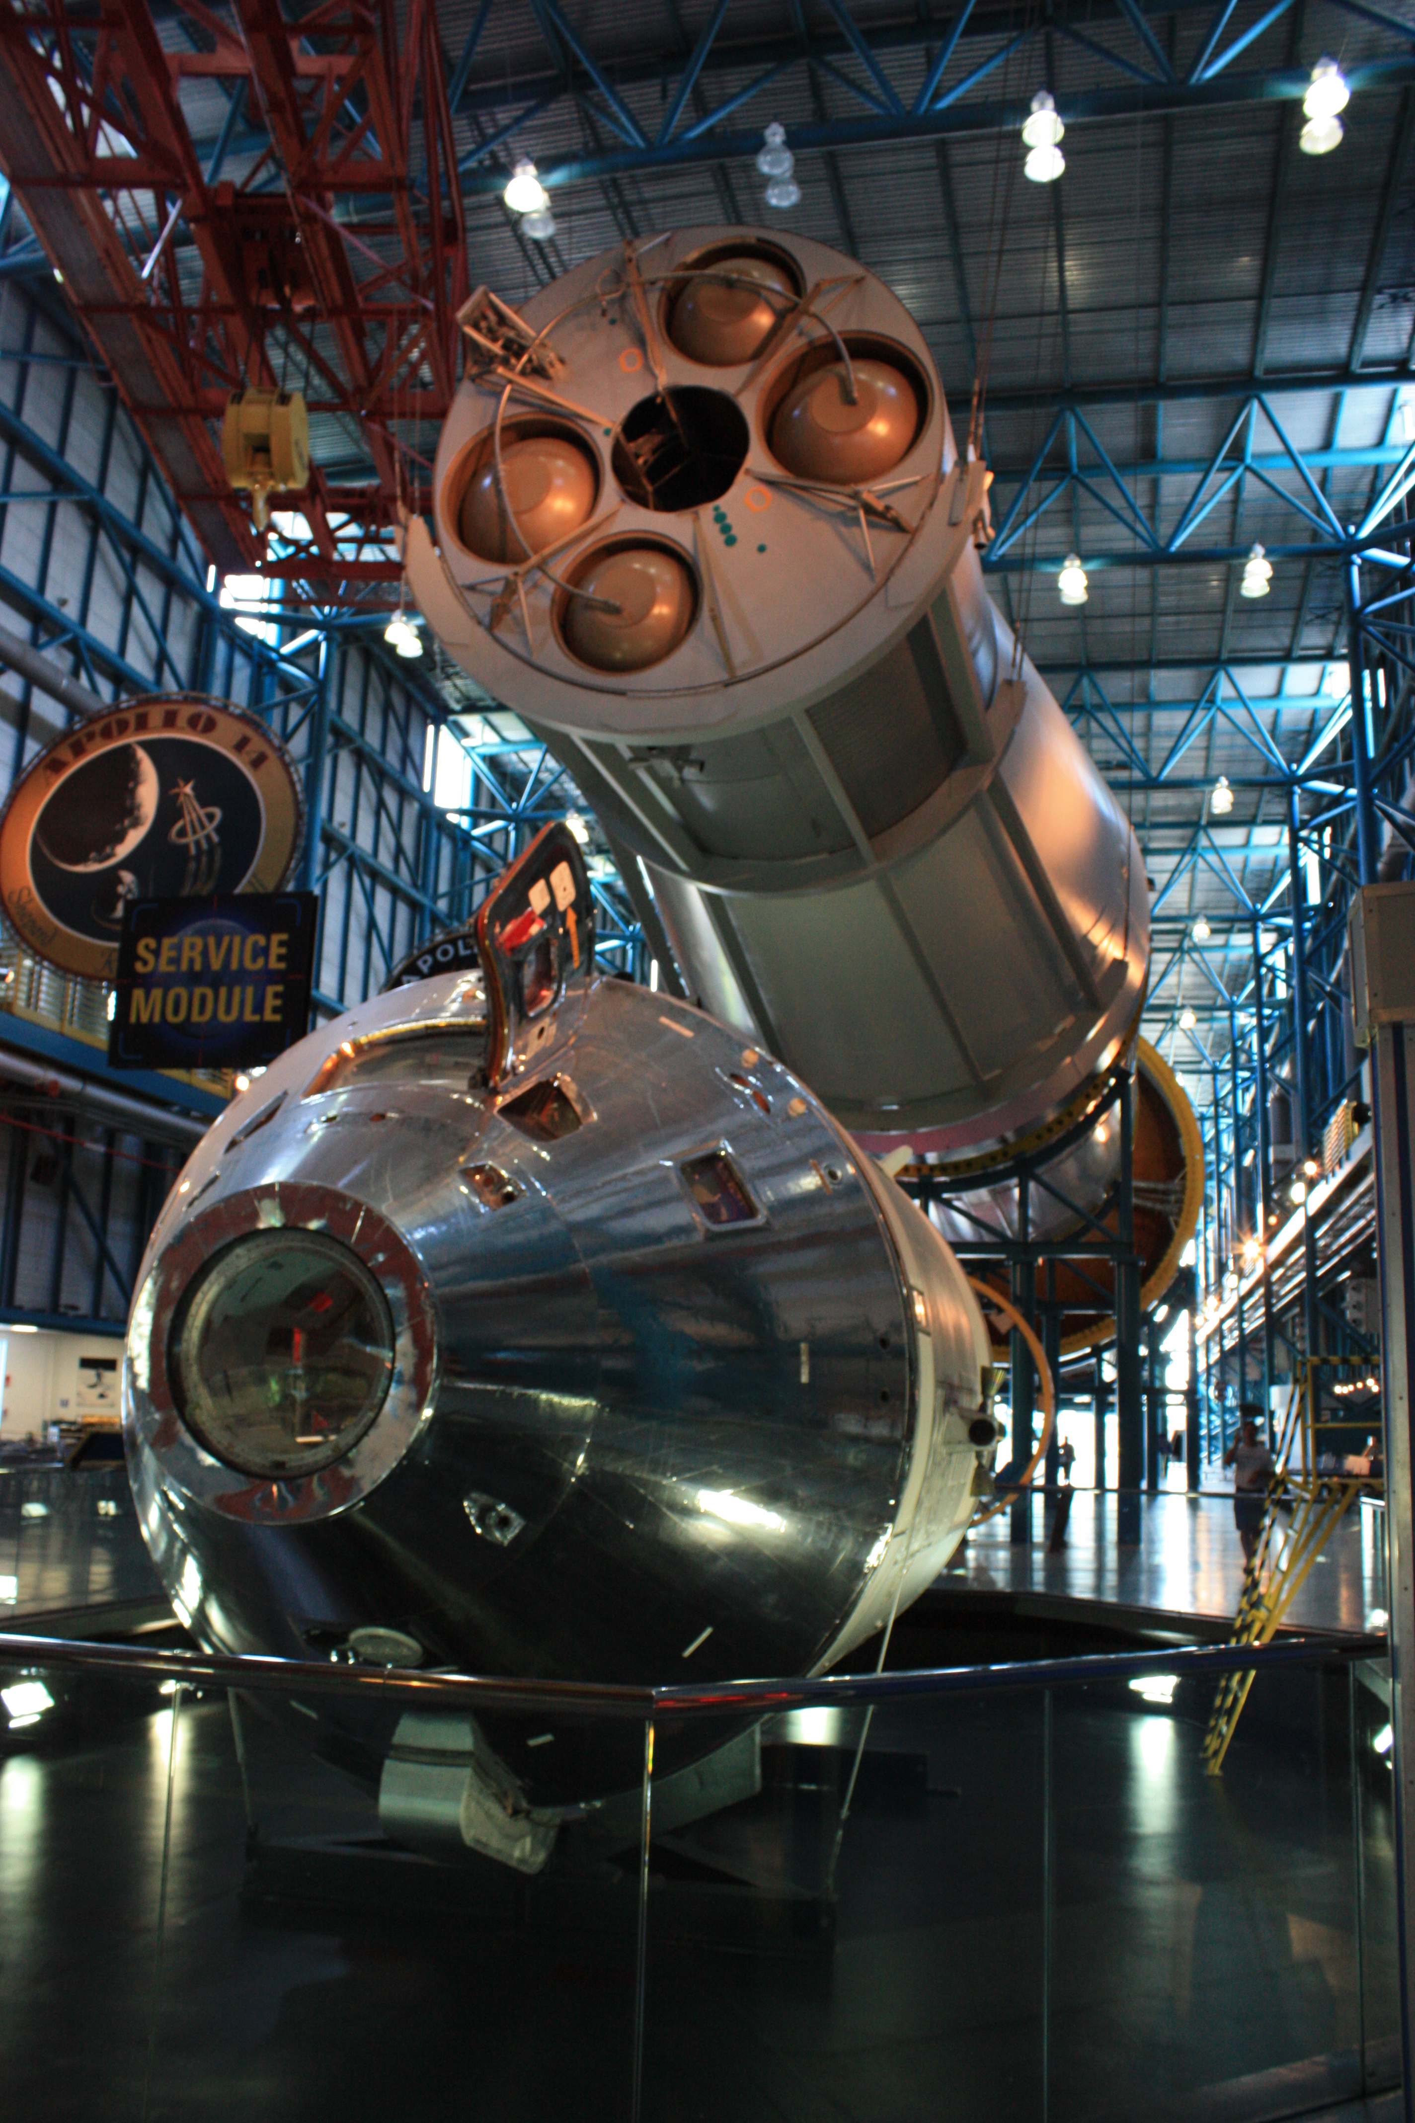
Building complicated things
Notes:
For the lazy among us: how to click together a completely customized linux distribution in 5 minutes!

Slide 5
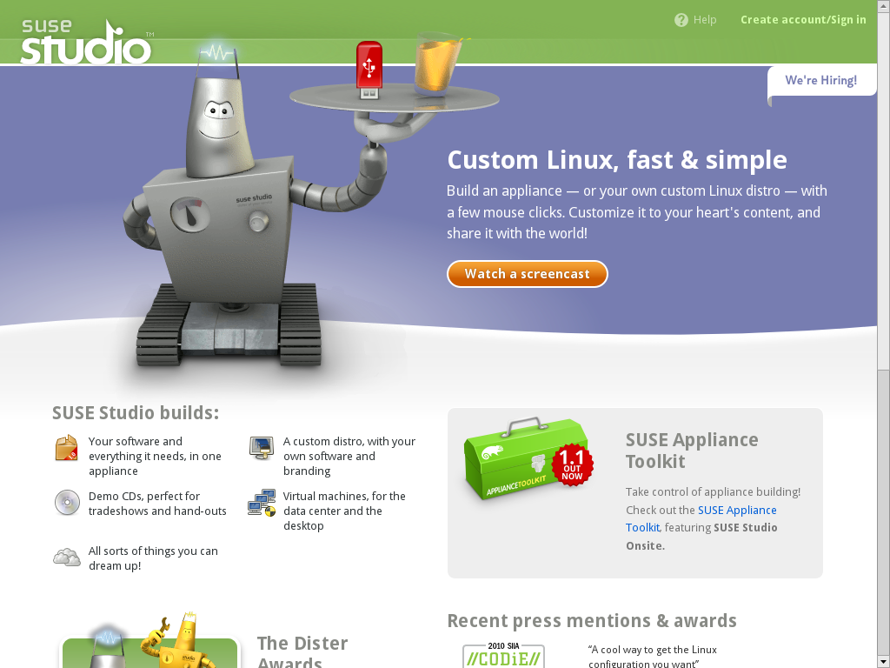
Notes:
The tool: SUSE Studio. Free to use on SUSEStudio.com!
Go there, log in via openID, Google or create an account.
It works simple: you choose to create a new appliance and give it a name.

Slide 6
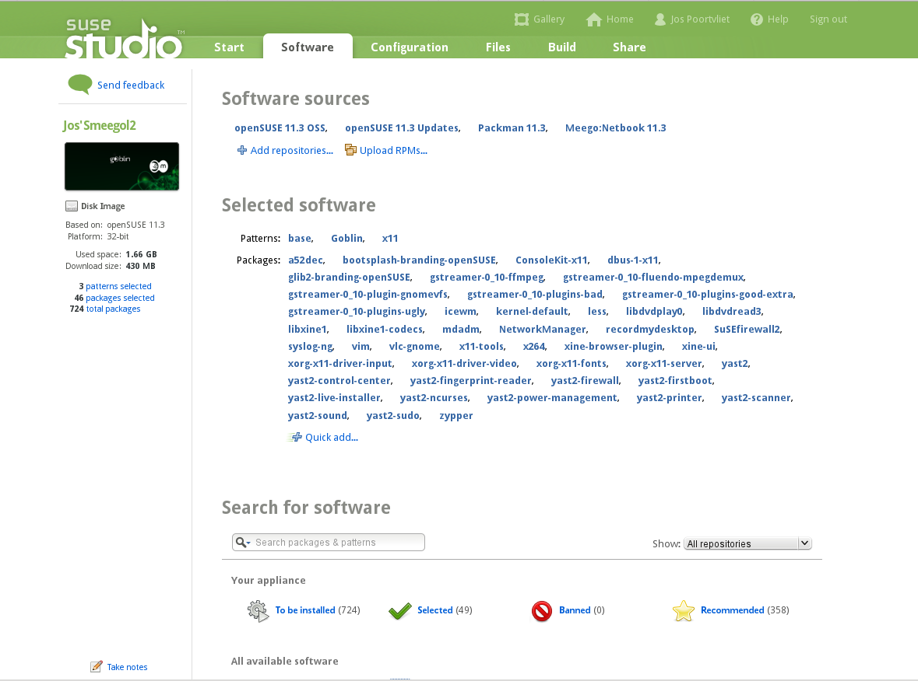
Notes:
pick a base template (SLE or openSUSE based): minimal OS, only X, minimal GNOME, full KDE, File/Print server etc.
Choose your own custom package selection from the 30.000 repositories on build.opensuse.org (or upload your own packages)

Slide 7

Notes:
choose your own custom artwork, configuration, scripts or upload overlay files. Anything can be changed!
Studio takes care of almost everything: if you configure MySQL but forget to add it, it will warn and help you.

Slide 8

Notes:
Configure your VM, hard drive, USB or CD/DVD output. You can also upload your newly build operating system directly to the Amazon EC2 Cloud!
You can include WebYast to control your new appliance remotely from the browser!

Slide 9

Notes:
Studio builds your OS like you want it.
BTW you can export and import KIWI config scripts. KIWI is the underlying tech of Studio, it is FOSS and developed in openSUSE. Gives even more control!

Slide 10
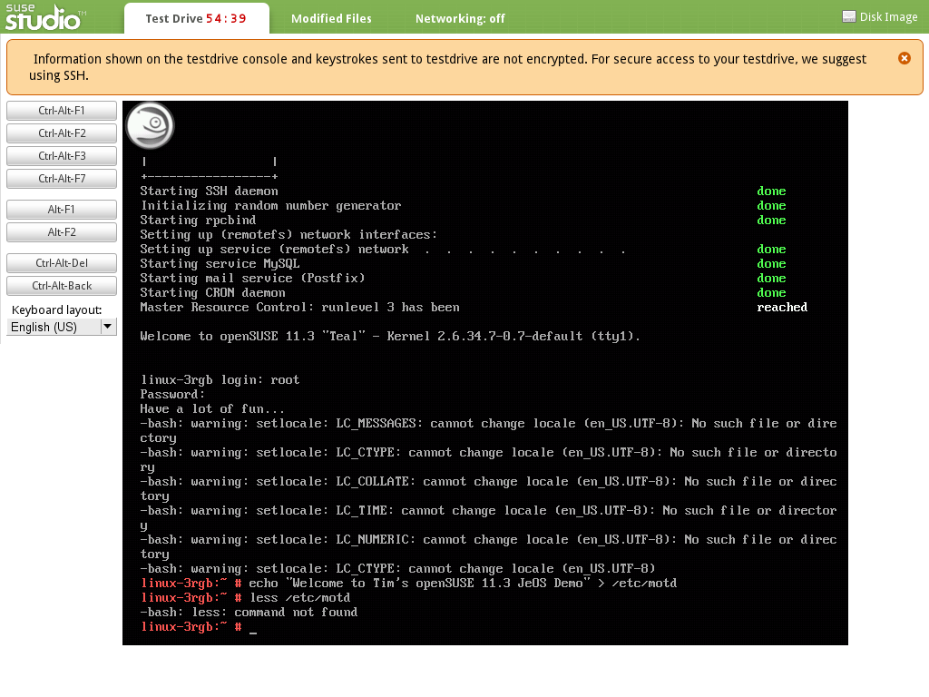
SUSEStudio.com
http://distributions.freedesktop.org/wiki/AppStream
Notes:
Once you are done you can test drive your appliance for 45 minutes through a flash plugin or via remote SSH. Any changes you make are saved in the appliance!
That's it, go and try it on susestudio.com!

Slide 11

Tumbleweed
Notes:
Next openSUSE project: Tumbleweed

Slide 12
Rolling on
Always the latest stable software
  Latest kernel = latest hardware support
  Latest browser, office, desktop, games...
Smoothly 'rolling' to the next release of openSUSE
No more 'download and install the new release'!
No more adding special repositories for newer software
Slightly more risk of breakage (price of living on the edge!)
Notes:
A roling release means that if newer software is released you will get it with an update after a short testing period
We developed Tumbleweed because we noticed that many openSUSE users had a large number of extra repositories (often 20 or more!) with newer versions of their software. While OBS is quite good, this can get messy if you mix incompatible repositories. Tumbleweed is much better as it is one repository.

Slide 13
How?
Open Build Service
  Just submit...
opensuse.org/Tumbleweed
Notes:
Having both a stable release and a rolling one would be almost impossible without OBS.
Tumbleweed is just another repository on the Build Service. Package maintainers can easily get their packages in Tumbleweed via OBS.
For users, it is simple to. Just add the repository, disable the others and do a zypper dup.
Go to opensuse.org/Tumbleweed for fun!

Slide 14

openQA
Notes:
The next project I want to talk about is openQA

Slide 15

Fully automated testing
Covers:
  Installation and upgrade testing
  Daily regression testing
  Application testing
  benchmarking
Gives clear overview of test results along with screenshots and video
Notes:
openQA is a automated testing system which runs daily tests on the openSUSE development tree 'Factory'.

Slide 16
How?
Boot ISO in VM (KVM or Qemu)
Give pre-defined input (mouse, keyboard)
Take screenshots of process
Compare screenshots with reference
Show results in web interface
Notes:
It works by booting up a ISO image (which is automatically generated daily from the Open Build Service) in a Virtual Machine. It installs it, boots, starts some applications and does a few simple actions. It takes screenshots during that process. It will then compare the screenshots it got with what was expected and thus know the test results.

Slide 17
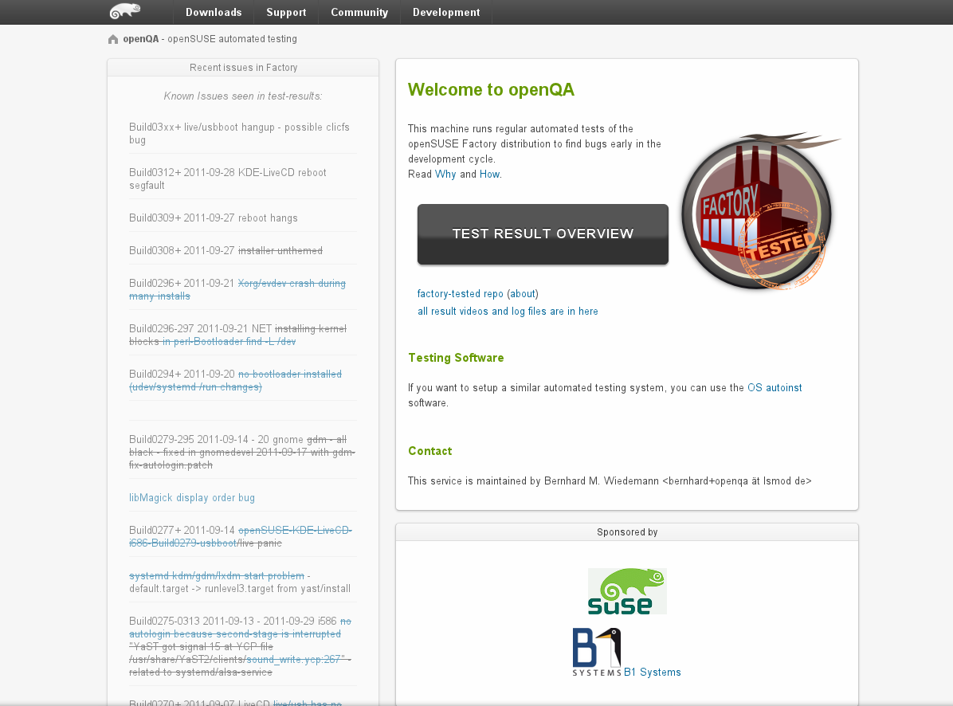
Notes:
This is the main interface of openqa.opensuse.org where you can check the test results.

Slide 18
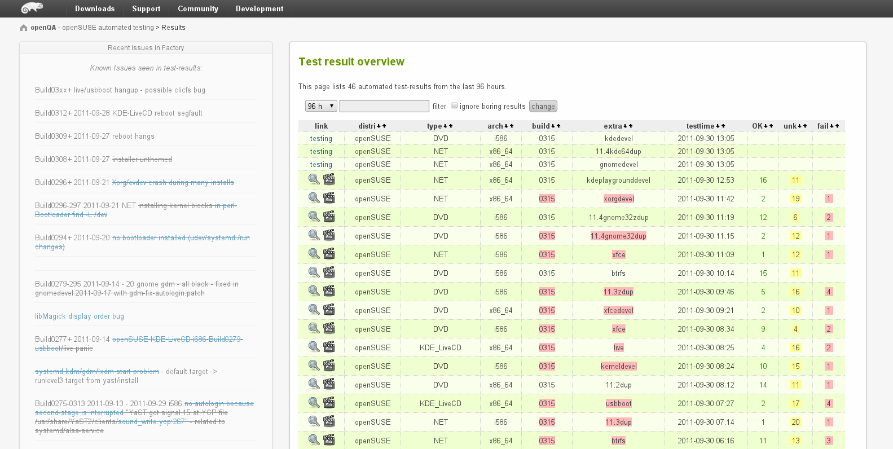
Notes:
Here is a list of tests which has run and the results.

Slide 19
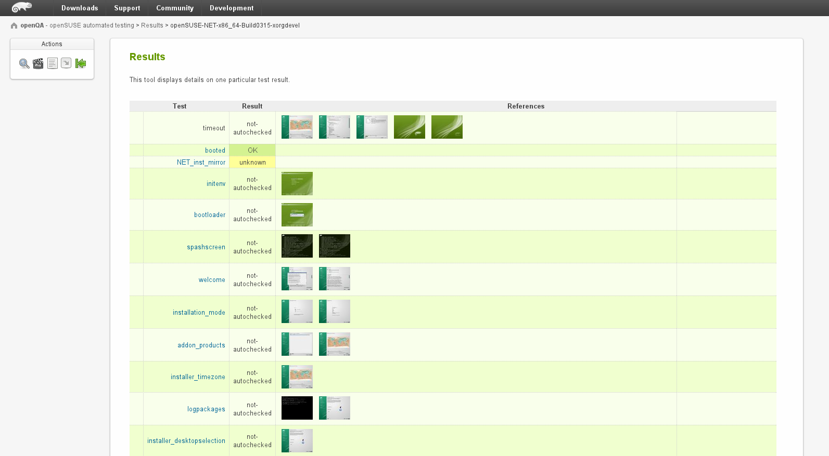
Notes:
You can see the details of a test, and as you can see you can download and inspect the screenshots.

Slide 20
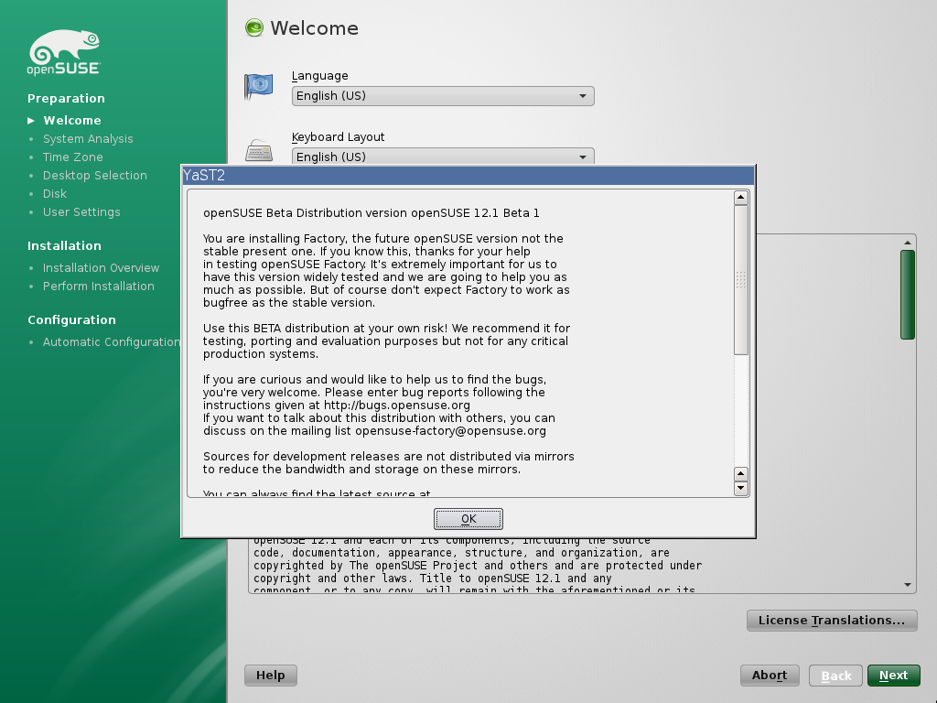
Notes:
Besides the screenshots openQA also offers video's of the whole process for download.

Slide 21

SuperKitty!
Notes:
By now everyone has to be convinced. openSUSE = super Kitty!
Awesome technology
Great plans

Slide 22

Newcomers welcome
Notes:
Which is always looking for new volunteers
people who actually want to make a difference!

Slide 23

opensuse.org
planet.opensuse.org
opensuse.org/Portal:How_to_participate
opensuse.org/Junior_jobs
features.opensuse.org
build.opensuse.org
openhatch.org
#opensuse-project

Slide 24

Join the gang
Notes:
... come join us and have fun...
Try openSUSE, Tumbleweed, SUSE Studio, TRY OBS, play with us!

Slide 25

Be a Geeko/Kitten
Notes:
Be the Geeko you can be!

Slide 26
Kitty Image credits
Me: Merlijn Hoek
You: artolog
openSUSE: clevergrrl
Novell: sensual shadows
Business: marissa cap
Strategy: dabogirl
Others: pasotraspaso
We are nice: cseeman
Beware: ian
SuperKitty: malingering
Cuddly: andreas solberg
Newcomers: abcrumly
Join the gang: malingering
GeekoKitten: no idea
To be found on Flickr under the above names with a Creative Commons license. Thanks all!

Slide 27
Your next Linux Distribution!

